Slide 1
Huntley community association
Annual general meeting
May 9, 2019
1

Slide 2
agenda
TOPIC | PRESENTER
Welcome & Introductions | Judy Makin, VP, Huntley Community Association
Approval of 2018 Minutes | Peter Green, Huntley Community Association
HCA Financial Report | Sam Bakewell, Huntley Community Association
Director reports | Various presenters
HCA Events and Activities | Various presenters
Question & Answer Period | Peter Green, Huntley Community Association
Election of HCA Board Directors | Eli El Chantiry, Counsellor Ward 5, City of Ottawa
Closing Remarks & Next Steps | Judy Makin, VP, Huntley Community Association
2

Slide 3
Getting started
Welcome and Introductions
Judy Makin
VP, Huntley Community Association
Approval of 2018 Minutes
Peter Green
Director, Huntley Community Association
3

Slide 4
HCA FINANCIALs sam bakewell
HUNTLEY COMMUNITY ASSOCIATION
2018 FINANCIAL HIGHLIGHTS
 | 2018 | 2017
BALANCE SHEET
Current Assets | 87,465 | 98,065
Current Liabilities | 9,318 | 11,209
 | 78,147 | 86,856
OPERATIONS
City Funding | 54,036 | 52,462
Other Revenue Sources | 75,757 | 81,489
Total Revenue | 129,793 | 133,951
Total Expenditures | 138,116 | 132,267
Net Operations | (8,323) | 1,684
Major Functions - 2018 | Income | Expenditure
Mess Hall (minus renovation cost) | 15,156 | 14,188
Outdoor Rink & ODR | 7,888 | 10,559
Ball Diamonds | 16,351 | 40,164
Soccer Fields | 5,551 | 9,567
Administration | 4,600 | 12,897
Drive-In Movies | 6,882 | 9,187
Burger Booth | 16,254 | 10,440
 | 72,682 | 107,002

Slide 5
Mess hall rentals – Pam meunier Jan to December 2018
Activity | Total # Events | Who Used?
Yearly Regular Groups | 6 | Beavers, Guides, Pool Club, Hunter Safety, WOCRC DINERS Club
Non Bar Events | 36 | Birthday Parties, Church Groups, Baby & Bridal Showers, Public Meetings, Commercial Staff Meetings, Workshops
Partial Year weekly groups | 4 | Zumba, Gym Guyz, Ottawa Fitness !
Meetings (Small Meeting Room) | 5 | Algonquin of Ontario, Bridge Club
5

Slide 6
Carp outdoor rink – peter green
Excellent ice again this year entirely due to Warren Lathem and his ice crew.
Rentals were down again – requires attention...
Potential solutions to increase rentals…
Primary client remains Outdoor Hockey Program
Introduced free ice on Wednesdays for Ringette - well attended and appreciated
Lot of Use - Good Deeds Cup video, in concert with the Sports Club and Chevrolet Canada.
Lots of room for a Winter Carnival focused on Outdoor Rink, VOLUNTEERS?
One 3v3 adult tournament in support of charity got reduced ice cost for one day rental
Weather hard on both ice making team and budget for maintenance
Thank you to:
Ice Crew - Warren Lathem, Joe Paloson, Doug Armstrong and Dave Creighton
City ‘muscle’ - Terry Boyd and Brian Boyd
“Snowmageddon” support - Georgie Carruthers
ODR Phone Team - Peggy and Wendy
Upcoming: summer rentals, pickle ball courts, a new Snowblower (City grant)
6
Notes:
SPEAKING NOTES:
The ice was excellent again this year entirely due to Warren Lathem and his ice crew.
Rentals were down again and this is an area that can certainly use some attention.
Potential solutions to increase rentals include:
Increase available time slots to 4 a week
Advertise to indoor hockey/West Carleton Junior B team
Advertise on social media
Increase social media presence concerning ice conditions
Primary client remains Outdoor Hockey Program
This year we introduced free ice on Wednesdays (6-8pm) for Ringette, which was well attended and very much appreciated
ODR was used a lot for the Good Deeds Cup video, in concert with the Sports Club and
Chevrolet Canada.
Lots of room for a Winter Carnival focused on Outdoor Rink, VOLUNTEERS?
One 3v3 adult tournament in support of charity got reduced ice cost for one day rental
Weather this year was extremely hard on the ice team, and subsequently the budget for ice maintenance
Thank you to: Warren Lathem, Joe Paloson, Doug Armstrong and Dave Creighton, who all worked as ice crew.
Thank you to Terry Boyd and Brian Boyd from the City who were exceptional help when issues arose that needed the City’s muscle.
Georgie Carruthers blew the ice off with his tractor when we had “snowmageddon” this past winter.
Peggy and Wendy were the phone team that organized 5:00am ice crews, thank you to them both
Upcoming: summer rentals, pickle ball courts, a new Snowblower (City grant)

Slide 7
Carp Softball/Ball Diamonds 2019 – peter green
Last year in Carp - 259 players, 12 teams and 16 coaches
Diamonds 1, 2 and Craig Side road were well used
Diamonds slowly improved - City 50/50 grant, fence capping and additional fencing
Additional improvements are to be budgeted into the HCA finance over the next several years.
Ontario Women’s CIS Fast Pitch Championships held in Carp in October 2018
Ontario U19 Men’s Fast Pitch championships scheduled in Carp over Canada Day long weekend.
West Carleton residents plan to bid on the Ontario Men’s Championships - summer 2020.
Thanks to:
Vicki Essex-Price - House league Softball convener
Geoff Lathem - diamond scheduler this year and many past years
7
Notes:
SPEAKING NOTES:
Last year there were 259 players in Carp
That was 12 teams with 16 coaches
Very popular program that requires a lot of volunteers
Short season is an attractive feature, doesn’t overlap too much with soccer.
Diamonds 1,2 and Craig Side road were well used
Diamonds have been slowly improved over last several years with a City 50/50 grant supporting some grass amending for safety purposes.
HCA bought fence capping last year and supported an additional 10 feet of fence added to the top of diamond two years ago.
Additional improvements are to be budgeted into the HCA finance over the next several years.
The Ontario Women’s CIS Fast Pitch Championships were held in Carp last October as a warm up for the Ontario U19 Men’s Fast Pitch championships scheduled for Carp this summer over the Canada Day weekend. This will be an excellent event for Carp and our excellent diamonds
A team of West Carleton residents plan to bid on the Ontario Men’s Championships if the U19s go well, which would be a major event for Carp in the summer of 2020. The HCA would play a support role for that event.
Vicki Essex-Price was the House league Softball convenor last season, and is again this season
Geoff Lathem was the diamond scheduler again this past year, something he has done for quite some time now
HCA Board hopes to convince him to be a board member after the AGM representing the Carp Ball Diamonds, their improvements and future.

Slide 8
HCA Events & Activities in 2018-19
Thank you to all the volunteers who participated in the following!
Garage Sale
Canada Day
Drive-in Movies
Burger Booth
Tornado fundraiser
Santa Claus Parade
8

Slide 9
2018 Burger Booth – peter green
Another successful Burger Booth at the Carp Fair in 2018
CAS support for new location is a gold mime
Profit in 2018 >$6000.00
Loss of DMG as beef supplier – continue with “Buy Local” mantra
Buns from Carp Bakery
2019 will likely see a change in assignments of shifts, resulting in VETERAN shifts working our busiest times
Burger Booth AGAIN had support West Carleton Business Community – thanks to:
Shouldice Mechanical, Stinson Fuels, Boston’s Best Coffee (Dillan Family
In September - opened special Burger Booth to support the West Carleton Disaster Relief efforts (Tornado) as part of the CAS special drive in Bingo.
HCA donated $750 from the Burger Booth Profits of that event.
9
Notes:
SPEAKING NOTES:
Another successful Burger Booth at the carp Fair this past year.
The CAS support for our new location has proven to be a gold mime
Made over $6000.00 in PROFITS this past year
Becoming much more of a business, less of a volunteer event
Loss of Friday evening sales entirely due to Tornado events but still ended up doing very well
Loss of DMG as beef supplier will lead to a new burger for 2019, but we hope the DMGwill rise from the ashes to renew our “Buy Local” mantra
Buns were from Carp Bakery
2019 will likely see a change in assignments of shifts, resulting in VETERAN shifts working our busiest times
The burger booth AGAIN had support from the West Carleton Business Community that made the event work. Shoudice Mechanical, Stinson Fuels, Boston’s Best Coffee (Dillan Family) all chipped in with free work, or product, that helped with our bottom line
In September we opened a special Burger Booth to support the West Carleton Disaster relief efforts (Tornado) as part of the CAS special drive in Bingo.
HCA donated $750 from the Burger Booth Profits of that event.

Slide 10
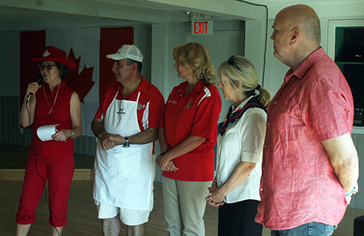
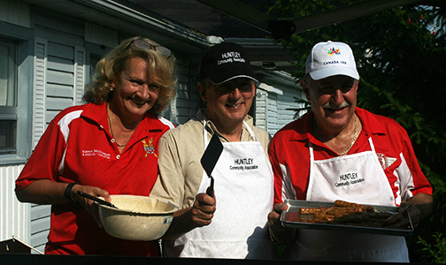
Canada Day Breakfast for Seniors – judy makin
Breakfast to 120 seniors – pancakes and sausages.
20 volunteers helped with set-up, decorating, welcoming, cooking, serving, clean-up.
All 3 levels of government officials attended - Eli El Chantiry, Merrilee Fullerton, Karen McCrimmon, and Senator Vern White.
Blistering heat! 47 degrees humidex
10

Slide 11
Directors’ Reports
Vice President – Judy Makin
Technology – Steve Fahie
Communication – Amy Baldry
Bar – Brian and Karen Nemes
Sports – Dan Kovacs (new)
Community Liaison – Al Joyner
Secretary / Transit – Will Rado
Directors at Large – Sandy Powell, Kathy Fischer, Nicolette Frosst (new)

Slide 12
Community liaison – alLan joyner
Community Liaison Overview – Allan Joyner
Communications - Amy Baldry; Newsletter, Facebook Group, Website
Participation in the FCA – Kathy Fischer
CAS - Peter Green
Consultations with the Carp Road Corridor BIA and The Carp BIA (Transit, Traffic )
Diefenbunker collaboration
Review of Development Applications - Information Not Advocacy
The new Official Plan - attendance in the open house for the new Official plan, planning community participation in the new Official Plan
Notes:
SPEAKING NOTES
bullet points for Community Liaison would be :
Allan overview
Kathy - Participation in the FCM
Allan - Consultations with the Carp Road Corridor BIA,
contacts with the councillors office,
review of development applications,
participation in public and semi private consultations around the cement plant application,
The new Official Plan - attendance in the open house for the new Official plan, planning community participation in the new Official Plan

Slide 13
West Carleton disaster relief – allan joyner, Judy Makin
September 2019 – Tornados completely destroy many homes, farms and businesses in Dunrobin & Kinburn.
Response by Kinburn and Dunrobin and Constance Bay CA’s augmented by HCA and Corkery CAs resulted in the formation of West Carleton Disaster Relief (WCDR).
All volunteers, WCDR brought bring five CAs to leverage and guide CAS, United Way and Red Cross support the 145 registered affected families. Included farm families.
Over $750k in funding; WCDR Volunteers working directly with those affected to ensure all funds donated go towards initiatives that are most needed.
After action reporting and Emergency Preparedness planning for West Carleton
The flood response, active in, response, recovery, preparedness phases.
United Way Community Builder Award shared with WCDR
Notes:
SPEAKING NOTES
The second category we need a slide for is West Carleton Disaster Relief
I’ll attach a graphic
- Tornado Response and the formation of WCDR
- After action reporting and Emergency Preparedness for planning for West Carleton
- Flood response now in the active phase
- the future
+++
In September 2019, a series of tornados left a 20 km trail of destruction across the former township of West Carleton, completely destroying many homes, farms and businesses in Dunrobin & Kinburn.
Tornado response and the formation of WCDR
From the efforts of volunteers, WCDR has emerged to bring our five largest communities & our local NGOs together to support the survivors; we are “One in Recovery”.
145 registered families.
After action reporting and Emergency Preparedness for planning for West Carleton
Flood response
Now in active phase
Planning for the future
West Carleton has started the down the road to recovery. There are many challenges ahead and the volunteers of the WCDR are working directly with those who are affected to ensure all funds donated go towards initiatives that are most needed.

Slide 14
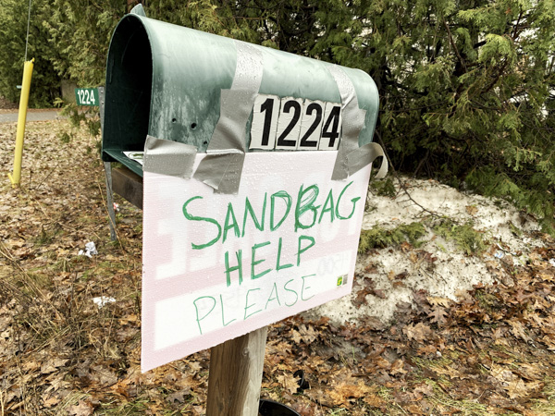
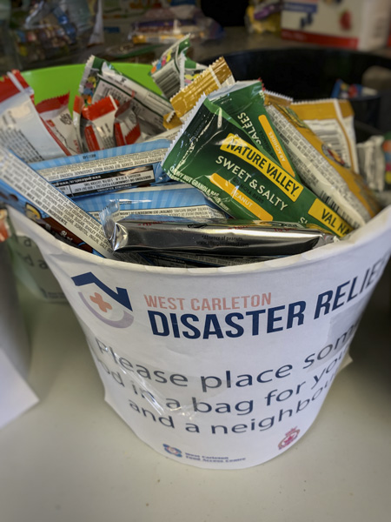
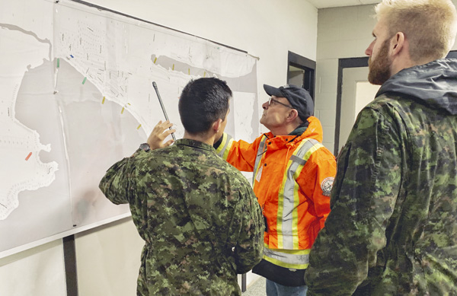
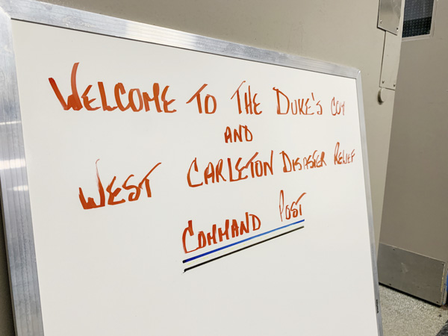
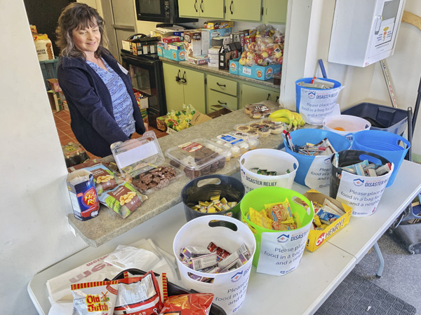
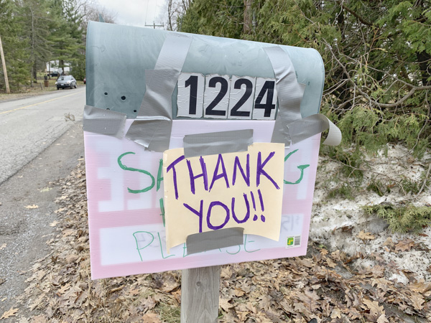
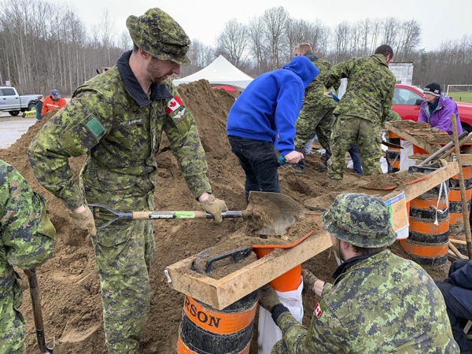

Slide 15
hCA Transit Meeting – April 2019 – will rado
45 people attended
Excellent presentations from representatives of OC Transpo, Belleville Transit and Innisfil Transit
~ 1 hour Q&A from a very engaged audience
Next steps - setting up a committee/working group with representation from the HCA, Village BIA, Carp Road BIA, and City Councillor's Office
Meeting materials can be found at http://hca-carp.ca/transit-options-for-carp/
Notes:
SPEAKING NOTES
I'd say that about 45 people attended
Excellent presentations from representatives of OC Transpo, Belleville Transit and Innisfil Transit
Approximately an hour of Q&A from a very engaged audience
Next steps involve setting up a committee/working group with representation from the HCA, Village BIA, Carp Road BIA, and City Councillor's Office
Meeting materials can be found at http://hca-carp.ca/transit-options-for-carp/
When I speak to the item during the meeting I'll elaborate on each point.

Slide 16
Vice President – Judy Makin
Reflections on 2018
Activities for adults and Seniors: Zumba, Bridge Lessons
Next year – Strategic Planning; governance structure

Slide 17
17

Slide 18
Election of Hca board directors
Eli El-Chantiry, Ottawa City Councillor, Ward 5 - West Carleton-March
Call for nominations for new Directors
Continuing Directors: Judy Makin, Jodi Bell, Will Rado, Pam Meunier, Brian Nemes, Karen Nemes, Sam Bakewell, Steve Fahie, Amy Baldry, Peter Green, Dan Kovacs, Al Joyner, Nicolette Frosst, Kathy Fischer
Vote
18

Slide 19
Closing remarks and connecting with us…
You can connect with us via any of the following…
If you would like to be added to our monthly newsletter, email info@hca-Carp.ca
https://www.facebook.com/groups/HuntleyCommunityAssociation/
https://twitter.com/hcacarp?lang=en
HCA website - http://hca-carp.ca/

